Slide 1
Detection of Alzheimer’s Disease
CSCI 630
Instructor: Prof. Huang Yuxiao
Darryl Pinto dp6417@rit.edu
Renzil Dourado rd9012@rit.edu

Slide 2
Topics:
Introduction
Problem Definition
Motivation
Method – Decision Tree
Data Cleaning
K means
CSV File
Training & Testing
Decision Tree
K nearest neighbors
Model Analysis and Results
Conclusion
Future scope

Slide 3
Introduction Problem Definition:
Alzheimer’s disease is a type of dementia which causes problems with memory, thinking, and normal behavior.
This disease is characterized with a reduction in the size of the brain.
The current detection systems use PET (Positron Emission Tomography) scans.
In this method radioactive fluid is injected into the patient to detect the glucose metabolism in the brain.

Slide 4
Introduction Motivation:
The PET scans mentioned above MAY have harmful effects, as a person must be exposed to some amount of radioactive fluid.
These fluids may have side effects on a patient such as allergic reactions.
Also, there are many precautions to be taken to prepare for this test, especially if a woman is pregnant.
Taking this into consideration, PET scans are advised to patients only in case of strong symptoms or in later stages of Alzheimer’s Disease.

Slide 5
Method:
Our proposed method makes use of MRI scans of a patient’s brain.
The dataset we used consists of 415 MRI scans of patients already known to have Alzheimer’s Disease.
The MRI scan had different colored pixels and the part of the brain that was shrunk appeared in black colored pixels (Not perfectly black).

Slide 6
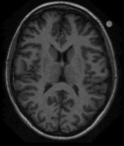
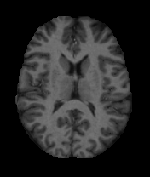
Data Cleaning
In order to obtain only the brain part of the MRI scan, skull stripping needed to be performed.
Raw Image Processed Image
We could use image processing to strip off the skull and obtain only the brain part of the scan.
Keep count of the number of perfectly black pixels.

Slide 7

K Means:
We then performed Image Analysis on each MRI scan to find the number of black, white and gray pixels.
This was done using K-means clustering in MATLAB with an output requirement of 3 clusters.
K-means clustered pixels of similar intensities into black, white and gray.

Slide 8
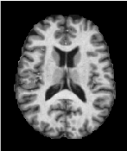
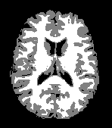
K Means:
Before K means After K means

Slide 9
CSV File:
A CSV file was created containing the information of each image and the type of pixels associated with it.
Based on a particular value for the number of black pixels, white pixels and gray pixels, each of these images were assigned a particular stage of the disease( Early/Middle/Final)

Slide 10
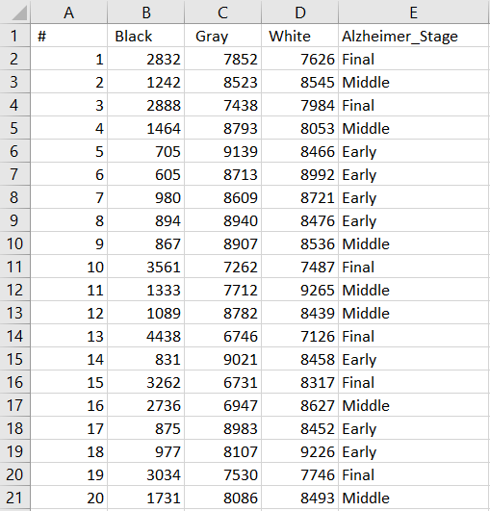
This CSV file looked like..

Slide 11
Training and Testing
We then split our dataset in the ratio 60:40 for training and testing respectively.
The CSV file containing 60% of the data was then used to create our model and a decision tree.
The remaining 40% of the data was then used to test the model created.

Slide 12
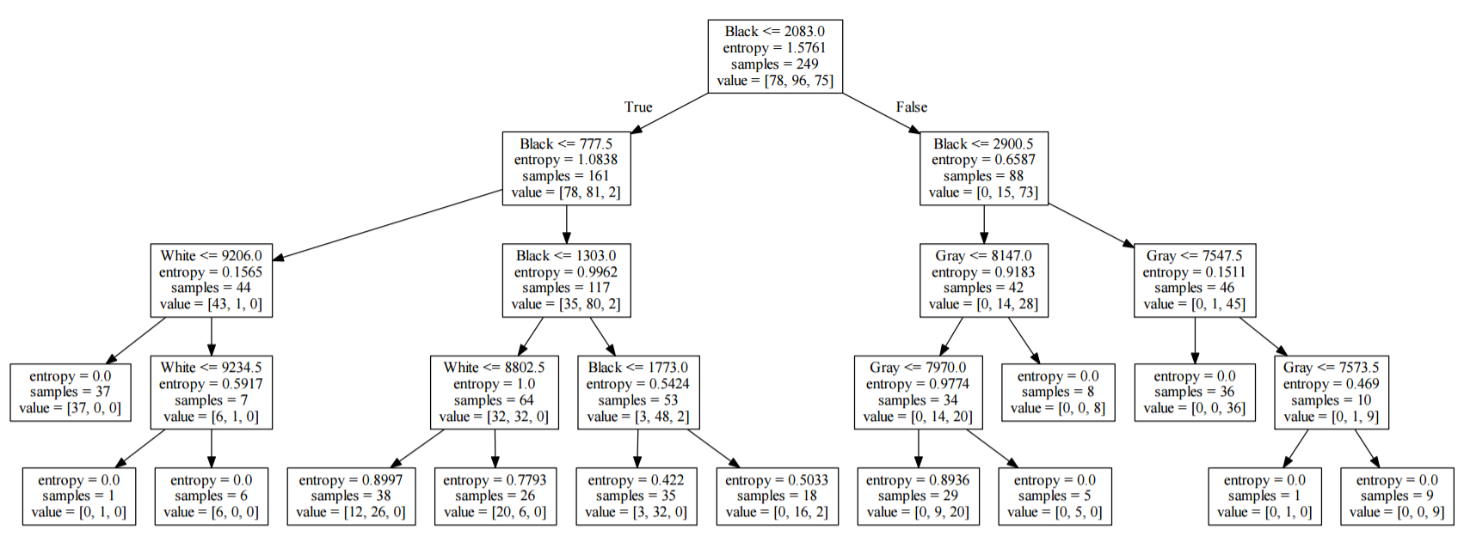
Decision Tree

Slide 13
K nearest neighbors
Another model built using KNN- K nearest neighbors method.
We provide the training dataset along with their labels.
Our data has 3 features, black, white and gray, so a 3D model.
For testing with k=11, it checks the labels of 11 neighbors, finds the nearest “group” and assigns this group’s label to the testing data.
Again 60:40 ratio was used for training : testing.

Slide 14
Model Analysis and Results using Decision Tree
Data Set size: 415
Training :Testing = 60:40
The overall accuracy of our Decision Tree model is approximately 72.28%.
Cross validation resulted in a more consistent accuracy of approximately 75.80%.
Predicted Class
CLASS | Early Stage | Middle Stage | Final Stage | Total
Early Stage | 41 | 14 | 1 | 56
Middle Stage | 12 | 45 | 10 | 67
Final Stage | 0 | 9 | 34 | 43
Total | 53 | 68 | 45 | 166
Actual Class

Slide 15
Model Analysis and Results using KNN
Data Set size: 415
Training :Testing = 60:40
The overall accuracy of our KNN model is approximately 81.92%.
Cross validation resulted in a more consistent accuracy of approximately 79.39%.
Predicted Class
CLASS | Early Stage | Middle Stage | Final Stage | Total
Early Stage | 49 | 7 | 1 | 57
Middle Stage | 9 | 53 | 6 | 68
Final Stage | 0 | 7 | 34 | 41
Total | 58 | 69 | 41 | 166
Actual Class

Slide 16
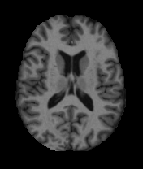
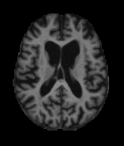
Conclusion
Given an input like

Slide 17
Middle Stage Final Stage
Conclusion
Our model will output

Slide 18
Conclusion
There isn’t a cure for Alzheimer’s Disease found yet, but if detected on time it will help patients to get the best medical care and most importantly time to look after their affairs.
Even in case of the most minor doubt, this test can be recommended as it is harmless.
This totally automates the detection process.

Slide 19
Future Scope
If we have access to more data, we would be able to train the model better.
If we have access to a dataset having MRI scans of a perfectly normal brain, the model will be able to detect the presence or absence of the disease as well.
If we obtain MRI scans which are already classified by professionals as early, middle and final stage, our model would be practical.
Possibly build a GUI, where we would be able to upload an MRI scan and display the stage of Alzheimer’s Disease.

Slide 20
Thank You

Slide 21
QUESTIONS?

